Slide 1



South East University
Department of Computer Science & Engineering
Faculty: Ashek Seum
Lecturer, Southest University

Slide 2
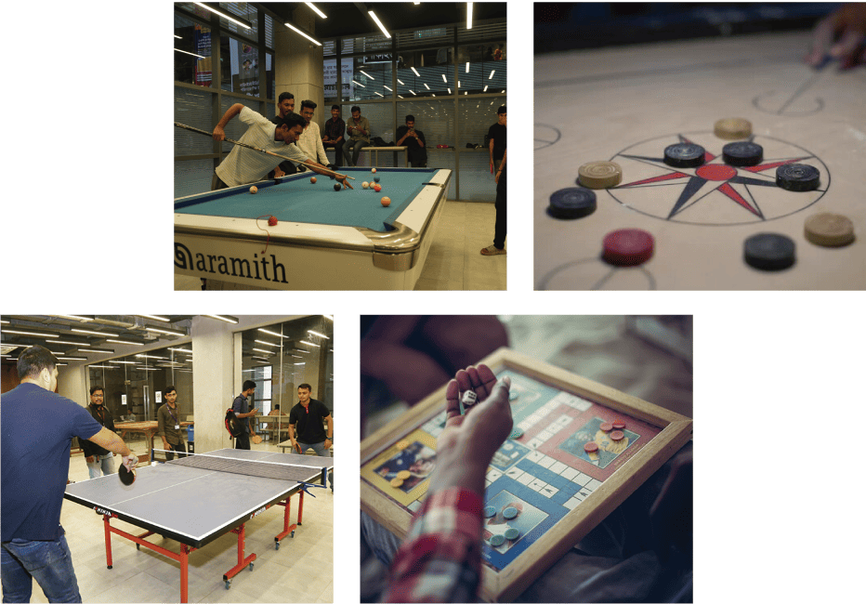
SEU Game Booking Management

Slide 3

Azhar Ullah
2020000010069
Sakib Hasan
2021200010048
Md Razibul Islam
2022100010015
Dalim Kumar Das
2022100010018

Slide 4
Introduction
What are Use Case Relationships?
Use case relationships define how different functionalities in a system interact and depend on each other. These relationships ensure the system is cohesive, reusable, and structured for scalability.

Slide 5
Motivations
In traditional game room management, bookings are handled manually, leading to scheduling conflicts and inefficiencies.
Students often visit the game room only to find no available slots, wasting their time.
Admins face challenges in managing game slots, monitoring usage, and resolving conflicts due to manual processes.
An online system can streamline bookings, provide real-time availability, and automate management tasks, ensuring a better experience for both students and admins.

Slide 6
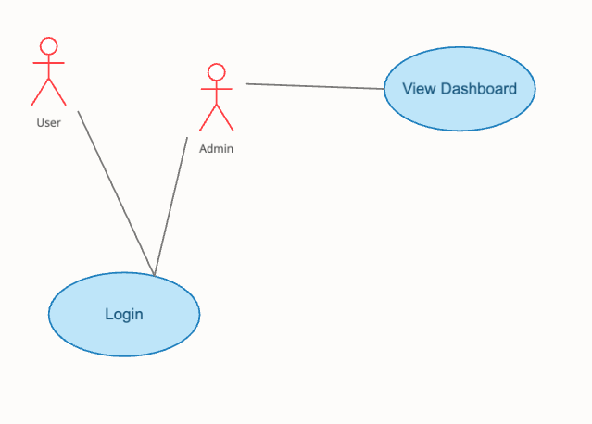
Use Case Relationships
Generalization Relationships

Slide 7
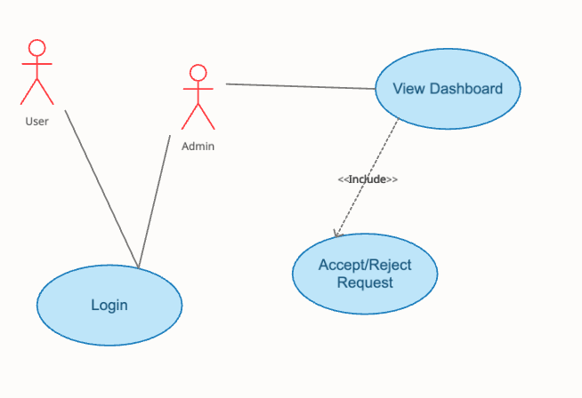
Use Case Relationships
Include Relationships

Slide 8
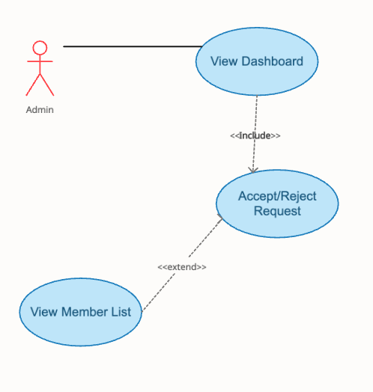
Use Case Relationships
Extend Relationships

Slide 9
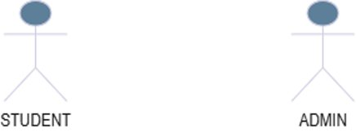
Primary Actors
This Game booking system involves with two types of primary actors.
Admin
Student

Slide 10
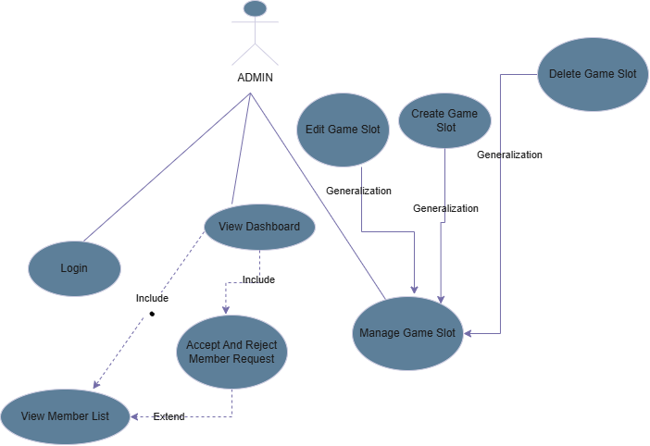
Admin Use Cases

Slide 11
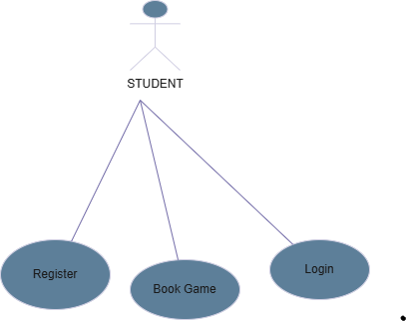
Student Use Cases

Slide 12
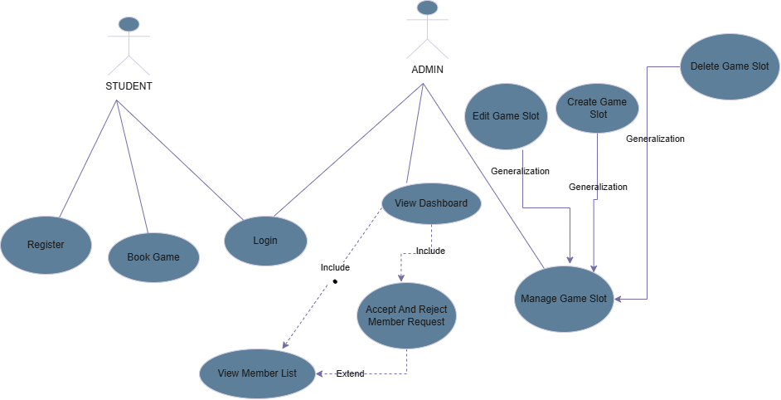
Combined Use Cases

Slide 13
Conclusion
The use case diagram for the Game Room Booking System highlights the interactions between Admin and Student, emphasizing their roles and tasks. It uses relationships like include, extend, and generalization to enhance clarity and modularity. This diagram provides a clear foundation for understanding the system's functionality, guiding its development and implementation.

Slide 14


